Slide 1


Novice2Pror
Open Source Education and Incentive Agent Platform Based on Open Source
Behavioral Data
Based on open source projects and datasets provided by the OpenSODA competition (GitHub 2020
global logs + Top 300 repository logs + OpenDigger metrics)
The fleeting years/Luyishan

Slide 2
Project Background and Problem Motivation
Background Description
Core Problems
Remote collaboration has become the norm in software
Newcomers don't know which projects and tasks to
development after the COVID-19 pandemic
start with
GitHub has become the world's most important open
Difficult to understand project activity and community
source collaboration platform
health
The number of new developers has surged but long-
Slow contribution feedback and lack of positive
term retention rate is low
incentives
Fragmented learning path and lack of systematic
guidance

Slide 3
竞赛契合度与赛题对齐
与OpenSODA宗旨的契合
本项目对应赛题方向
利用真实开源行为数据分析开源生态
开源教育与开源激励相关的工具与服务
构建数据驱动的创新应用
面向开源治理与运营的智能化应用
强调开源教育、贡献激励与社区可持续发展
开源社区贡献者行为分析与预测

Slide 4

项目目标与整体思路
项目目标
构建面向新手与成长型开发者的“可学习、可推荐、可激励”的开源参与引
导平台
核心思路
用数据理解开源参与规律
用模型总结高质量成长路径
用AI Agent实现个性化引导与激励

Slide 5
Data Selection and Source Description
01
GitHub Global Logs January 2020
Typical remote collaboration behavior samples during early COVID-19
Used to establish novice behavior baseline
02
Top 300 Repository Logs (2020.01–2023.03)
Long-term collaboration data from mature open source projects
Used to extract healthy project and high-quality contribution patterns
03
OpenDigger Metrics (including OpenRank)
Official quantitative metrics system for open source ecosystem
Used for impact assessment and incentive mechanism design

Slide 6
Data Methodology (Field—Question—Function)
Methodology Note: This project does not directly use fields, but rather uses fields to answer behavioral questions and map to system
functions
Data Field
Research Question
Functional Role
actor_id/actor_login
Determine if the developer is a novice
Used for building developer profiles
type/action
Clarify behavior type
Used for determining contribution stage
issue_created_at/closed_at
Analyze if Issue response is timely
Used for project health assessment
Used for novice positive feedback
pull_merged
Check if PR is accepted
modeling
openrank json
Quantify contribution impact
Used for incentive points and badges

Slide 7
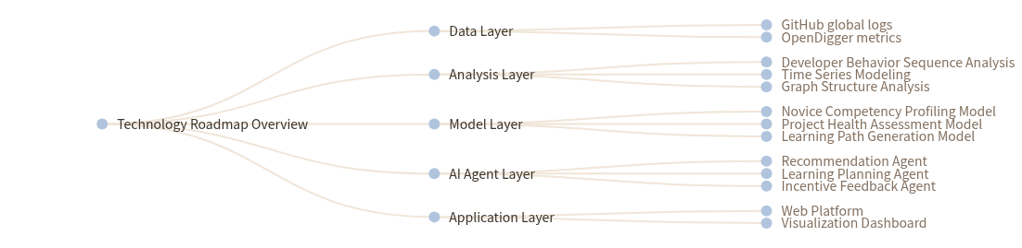
Technology Roadmap Overview
Overall Technology Roadmap: Data Layer: GitHub global logs + OpenDigger metrics; Analysis Layer: Developer Behavior Sequence Analysis, Time
Series Modeling, Graph Structure Analysis; Model Layer: Novice Competency Profiling Model, Project Health Assessment Model, Learning Path
Generation Model; AI Agent Layer: Recommendation Agent, Learning Planning Agent, Incentive Feedback Agent; Application Layer: Web Platform +
Visualization Dashboard.

Slide 8
Core Innovation 1: Data-Driven Learning Path Generation
Innovation Description
Based on real historical behavioral data, not manual rules
Extract typical growth paths of high-retention contributors
Construct progressive learning paths from low threshold to high value
Path Example
Documentation Contribution → Issue Comment → Issue Submission → PR Submission → Core Contribution

Slide 9
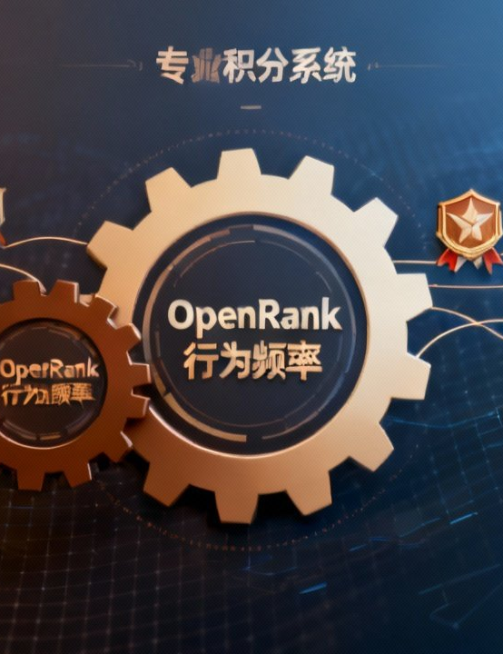
Core Innovation 2: OpenRank-driven Incentive Mechanism
Design Philosophy
Traditional contribution counting cannot reflect real influence
OpenRank can measure long-term, structured contribution value
Incentive Mechanism Design
OpenRank × Behavioral Frequency → Points System
Points → Levels and Badges
Levels → Learning Path and Task Recommendation Weighting

Slide 10
AI Agent Collaborative Design
Multi-Agent Division of Labor:
Project Recommendation
Learning Path Planning
Incentive Feedback Agent
Agent
Agent
Providing real-time feedback and
Matching developer capabilities with
Generating phased growth goals and
growth visualization
project health
recommendations
Advantages: Scalable, explainable, and continuously optimizable

Slide 11

Application Scenarios and Value
Application Scenarios
Open source introduction guidance for novice
developers
University open source courses and practical teaching
Cultivation of new contributors in open source
communities
Talent observation and incentive mechanism for
corporate OSPO
Value Proposition
Lowering the threshold for open source participation
Increasing community activity and retention rate
Promoting the healthy development of open source
digital ecosystem

Slide 12


Summary and Outlook
Project Summary
Novice2Pror is built on real open source behavioral data with AI Agent at its core,
deeply integrating learning, practice, and incentive mechanism to construct future-oriented
open source education and incentive infrastructure
Future Expansion
Incorporate more languages and communities
Support enterprise-level OSPO scenarios
Open source platform evolution

